Slide 1
SECURITY
Олег Маркевич
Роман Паробій

Slide 2
AGENDA
THREAT MODELING AS PART OF SDLC
WHAT IS STRIDE MODEL:
SPOOFING
TAMPERING
REPUDIATION
INFORMATION DISCLOSURE
DENIAL OF SERVICE
ELEVATION OF PRIVILEGES
THREAT MODELING PROCESS
MICROSOFT THREAT MODELING TOOL

Slide 3

THREAT MODELING AS PART OF SDLC
IT IS BETTER TO ADOPT SECURITY PRACTICES AS EARLY AS POSSIBLE
SDLC - SOFTWARE DEVELOPMENT LIFE CYCLE
WHAT IS THREAT MODEL?
THREAT MODELING IS A PROCESS BY WHICH POTENTIAL THREATS, SUCH AS STRUCTURAL VULNERABILITIES, CAN BE IDENTIFIED, ENUMERATED, AND PRIORITIZED – ALL FROM A HYPOTHETICAL ATTACKER’S POINT OF VIEW. THE PURPOSE OF THREAT MODELING IS TO PROVIDE DEFENDERS WITH A SYSTEMATIC ANALYSIS OF THE PROBABLE ATTACKER’S PROFILE, THE MOST LIKELY ATTACK VECTORS, AND THE ASSETS MOST DESIRED BY AN ATTACKER.
THERE ARE VARIOUS WAYS AND METHODOLOGIES OF DOING THREAT MODELS, ONE OF WHICH IS A PROCESS POPULARIZED BY MICROSOFT, CALLED STRIDE

Slide 4

WHAT IS STRIDE MODEL?
A MODEL OF THREATS DEVELOPED BY PRAERIT GARG AND LOREN KOHNFELDER AT MICROSOFT FOR IDENTIFYING COMPUTER SECURITY THREATS. IT PROVIDES A MNEMONIC FOR SECURITY THREATS IN SIX CATEGORIES:
SPOOFING
TAMPERING
REPUDIATION
INFORMATION DISCLOSURE (DATA BREACH OR DATA LEAK)
DENIAL OF SERVICE
ELEVATION OF PRIVILEGE
ANSWERS THE QUESTION: "WHAT CAN GO WRONG IN THIS SYSTEM WE ARE WORKING ON?"
REQUIRES A FULL BREAKDOWN OF PROCESSES, DATA STORES, DATA FLOWS AND TRUST BOUNDARIES

Slide 5
SPOOFING - CLAIMING YOU ARE SOMEBODY ELSE
VIOLATES AUTHENTICITY PROPERTY OF THE SYSTEM
MANY OF THE PROTOCOLS IN THE TCP/IP SUITE DO NOT PROVIDE MECHANISMS FOR AUTHENTICATING THE SOURCE OR DESTINATION OF A MESSAGE
EXAMPLES:
ONE USER SPOOFS THE IDENTIFY OF ANOTHER USER BY BRUTE-FORCING USERNAME/PASSWORD CREDENTIALS.
A MALICIOUS, PHISHING HOST IS SET UP IN AN ATTEMPT TO TRICK USERS INTO DIVULGING THEIR CREDENTIALS.
CAN BE MITIGATED WITH PROPER AUTHENTICATION

Slide 6
TAMPERING - MODIFICATION IN A HARMFUL WAY
VIOLATES INTEGRITY PROPERTY OF THE SYSTEM
EXAMPLES:
A USER PERFORMS BIT-FLIPPING ATTACKS ON DATA IN TRANSIT.
A USER MODIFIES DATA AT REST/ON DISK.
A USER PERFORMS INJECTION ATTACKS ON THE APPLICATION.
A USER REPLACES A PART OF APPLICATION (DLL) WITH A MALICIOUS ONE.
CAN BE MITIGATED WITH:
PROPER VALIDATION OF USERS' INPUTS AND PROPER ENCODING OF OUTPUTS.
USE PREPARED SQL STATEMENTS OR STORED PROCEDURES TO MITIGATE SQL INJECTIONS.
INTEGRATE WITH SECURITY STATIC CODE ANALYSIS TOOLS TO IDENTIFY SECURITY BUGS.
INTEGRATE WITH COMPOSITION ANALYSIS TOOLS (E.G. SNYK, NPM AUDIT, BLACKDUCK ...ETC) TO IDENTIFY 3RD PARTY LIBRARIES/DEPENDENCIES WITH KNOWN SECURITY VULNERABILITIES.

Slide 7
REPUDIATION - DENYING THAT SPECIFIC EVENT OCCURED
VIOLATES NON-REPUDIATION PROPERTY OF THE SYSTEM
EXAMPLES:
A USER DENIES PERFORMING A DESTRUCTIVE ACTION (E.G. DELETING ALL RECORDS FROM A DATABASE).
ATTACKERS COMMONLY ERASE OR TRUNCATE LOG FILES AS A TECHNIQUE FOR HIDING THEIR TRACKS.
ADMINISTRATORS UNABLE TO DETERMINE IF A CONTAINER HAS STARTED TO BEHAVE SUSPICIOUSLY/ERRATICALLY.
CAN BE MITIGATED WITH:
PROPER AUDITING OF ACTIONS PERFORMED
SECURE LOGGING
MESSAGE AUTHENTICATION CODES OR DIGITAL SIGNATURES

Slide 8
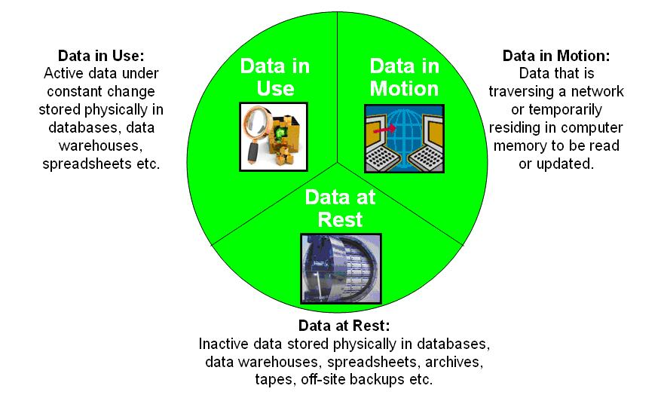
INFORMATION DISCLOSURE - DATA LEAKS AND DATA BREACHES
VIOLATES CONFIDENTIALITY PROPERTY OF THE SYSTEM
DATA LEAK AND DATA BREACH - WHAT IS THE DIFFERENCE?
DATA BREACH - A VULNERABLE SYSTEM WAS ATTACKED BY HACKER
DATA LEAK - INFORMATION IS EXPOSED AS A RESULT OF MISTAKE OR COMPANY INTERNAL PROCESS
MAY CAUSE IDENTITY THEFT
MAY HAPPEN TO DATA IN USE, DATA IN MOTION AND EVEN DATA AT REST

Slide 9
INFORMATION DISCLOSURE - DATA LEAKS AND DATA BREACHES
EXAMPLES:
A USER IS ABLE TO EAVESDROP, SNIFF, OR READ TRAFFIC IN CLEAR-TEXT.
A USER IS ABLE TO READ DATA ON DISK IN CLEAR-TEXT.
A USER ATTACKS AN APPLICATION PROTECTED BY TLS BUT IS ABLE TO STEAL X.509 (SSL/TLS CERTIFICATE) DECRYPTION KEYS AND OTHER SENSITIVE INFORMATION. (HEARTBLEED OPENSSL BUG)
A USER IS ABLE TO READ SENSITIVE DATA IN A DATABASE.
CAN BE MITIGATED WITH:
IMPLEMENTING PROPER ENCRYPTION.
AVOIDING SELF-SIGNED CERTIFICATES. USE A VALID, TRUSTED CERTIFICATE AUTHORITY (CA).

Slide 10
DENIAL OF SERVICE - SERVICE OR NETWORK RESOURCE BECOMES UNAVAILABLE TO END USERS
VIOLATES AVAILABILITY PROPERTY OF THE SYSTEM
FLOODING THE TARGETED MACHINE OR RESOURCE WITH SUPERFLUOUS REQUESTS IN AN ATTEMPT TO OVERLOAD SYSTEMS
DOS AND DDOS
EXAMPLES:
HTTP POST ATTACK - VERY SLOWLY SENDING A LEGITIMATE POST MESSAGE WITH BIG BODY (LONG ‘CONTENT-LENGTH IN HEADER), BLOCKING SERVER RESOURCE
SYN FLOOD ATTACK - ATTACKER SENDS SYN REQUEST (TCP THREE-STEPS HANDSHAKE) REPEATEDLY
CAN BE MITIGATED WITH:
FRONT END HARDWARE THAT ANALYZES PACKAGES
FIREWALLS
RESOURCE CONSUMPTION CONTROL

Slide 11
ELEVATION OF PRIVILEGES - GAINING ACCESS YOU SHOULD NOT HAVE
VIOLATES AUTHORIZATION PROPERTY OF THE SYSTEM
TWO WAYS: VERTICAL AND HORIZONTAL
EXAMPLES:
A USER TAKES ADVANTAGE OF A BUFFER OVERFLOW TO GAIN ROOT-LEVEL PRIVILEGES ON A SYSTEM.
JAILBREAKING - ALLOWING USER TO ACCESS FILES OUTSIDE THE FILESYSTEM THAT ADMINISTRATOR MADE AVAILABLE.
ROOTING - GETTING PRIVILEGED CONTROL OVER SUBSYSTEMS (SUPERUSER RIGHTS).
CAN BE MITIGATED WITH:
PROPER AUTHORIZATION MECHANISM (ROLE-BASED ACCESS CONTROL).
SECURITY STATIC CODE ANALYSIS TO ENSURE APPLICATION CODE HAS LITTLE TO NO SECURITY BUGS.
USE DEPENDENCY CHECK TOOLS TO ENSURE THAT APPLICATION IS NOT RELYING ON KNOWN-VULNERABLE 3RD PARTY DEPENDENCIES.
GENERALLY PRACTICING LEAST PRIVILEGE PRINCIPLE.

Slide 12
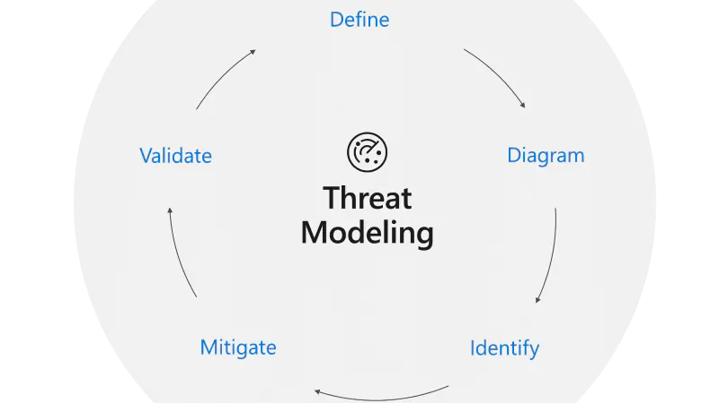
THREAT MODELING PROCESS
5 MAJOR STEPS:
DEFINING SECURITY REQUIREMENTS.
CREATING AN APPLICATION DIAGRAM.
IDENTIFYING THREATS.
MITIGATING THREATS.
VALIDATING THAT THREATS HAVE BEEN MITIGATED.

Slide 13
Microsoft Threat Modeling Tool
Communicate about the security design of their systems
Analyze those designs for potential security issues using a proven methodology
Suggest and manage mitigations for security issues

Slide 14
Microsoft Threat Modeling Tool
Automation
STRIDE per Element
Reporting
Unique Methodology

Slide 15
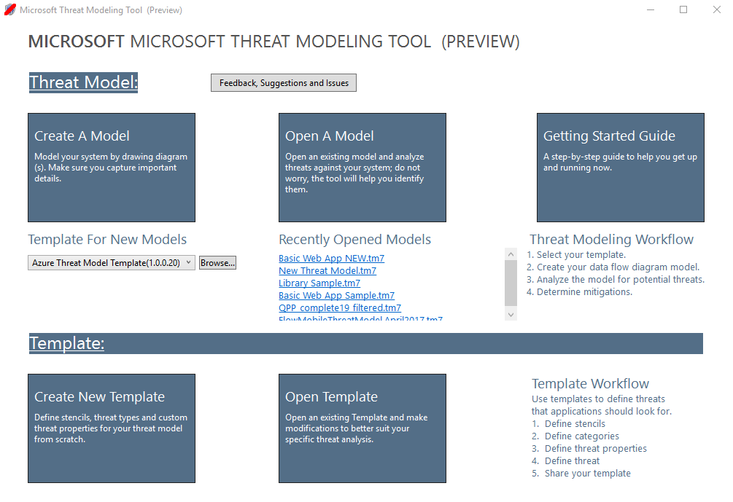
Main page of an application

Slide 16
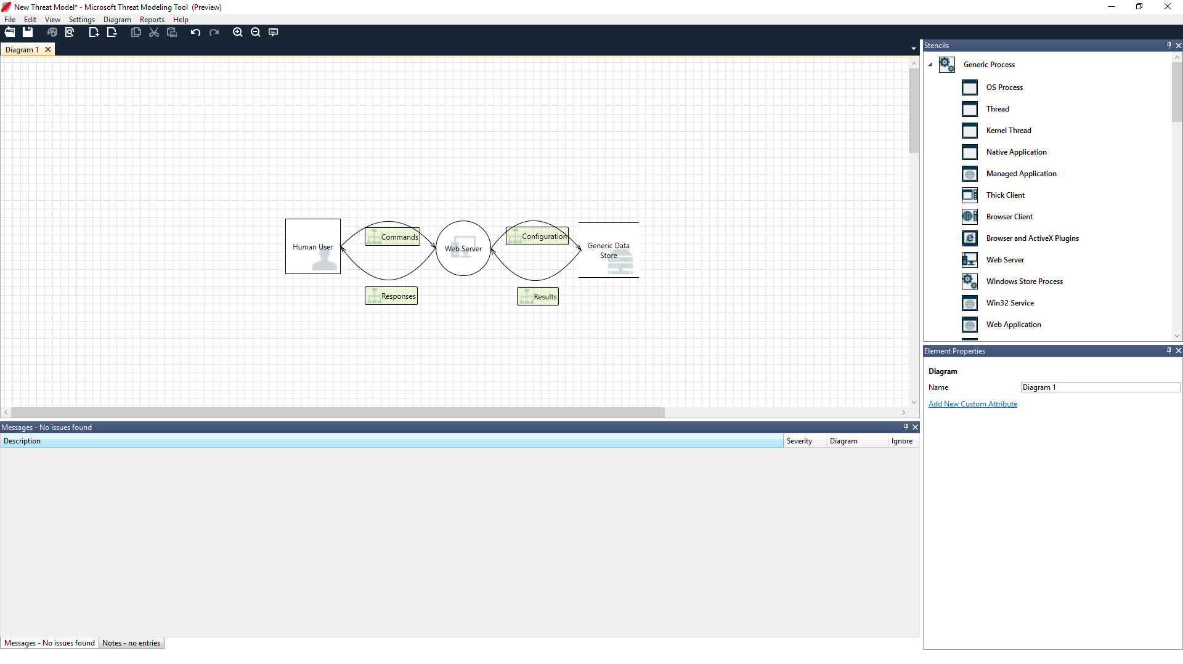
Building a model

Slide 17
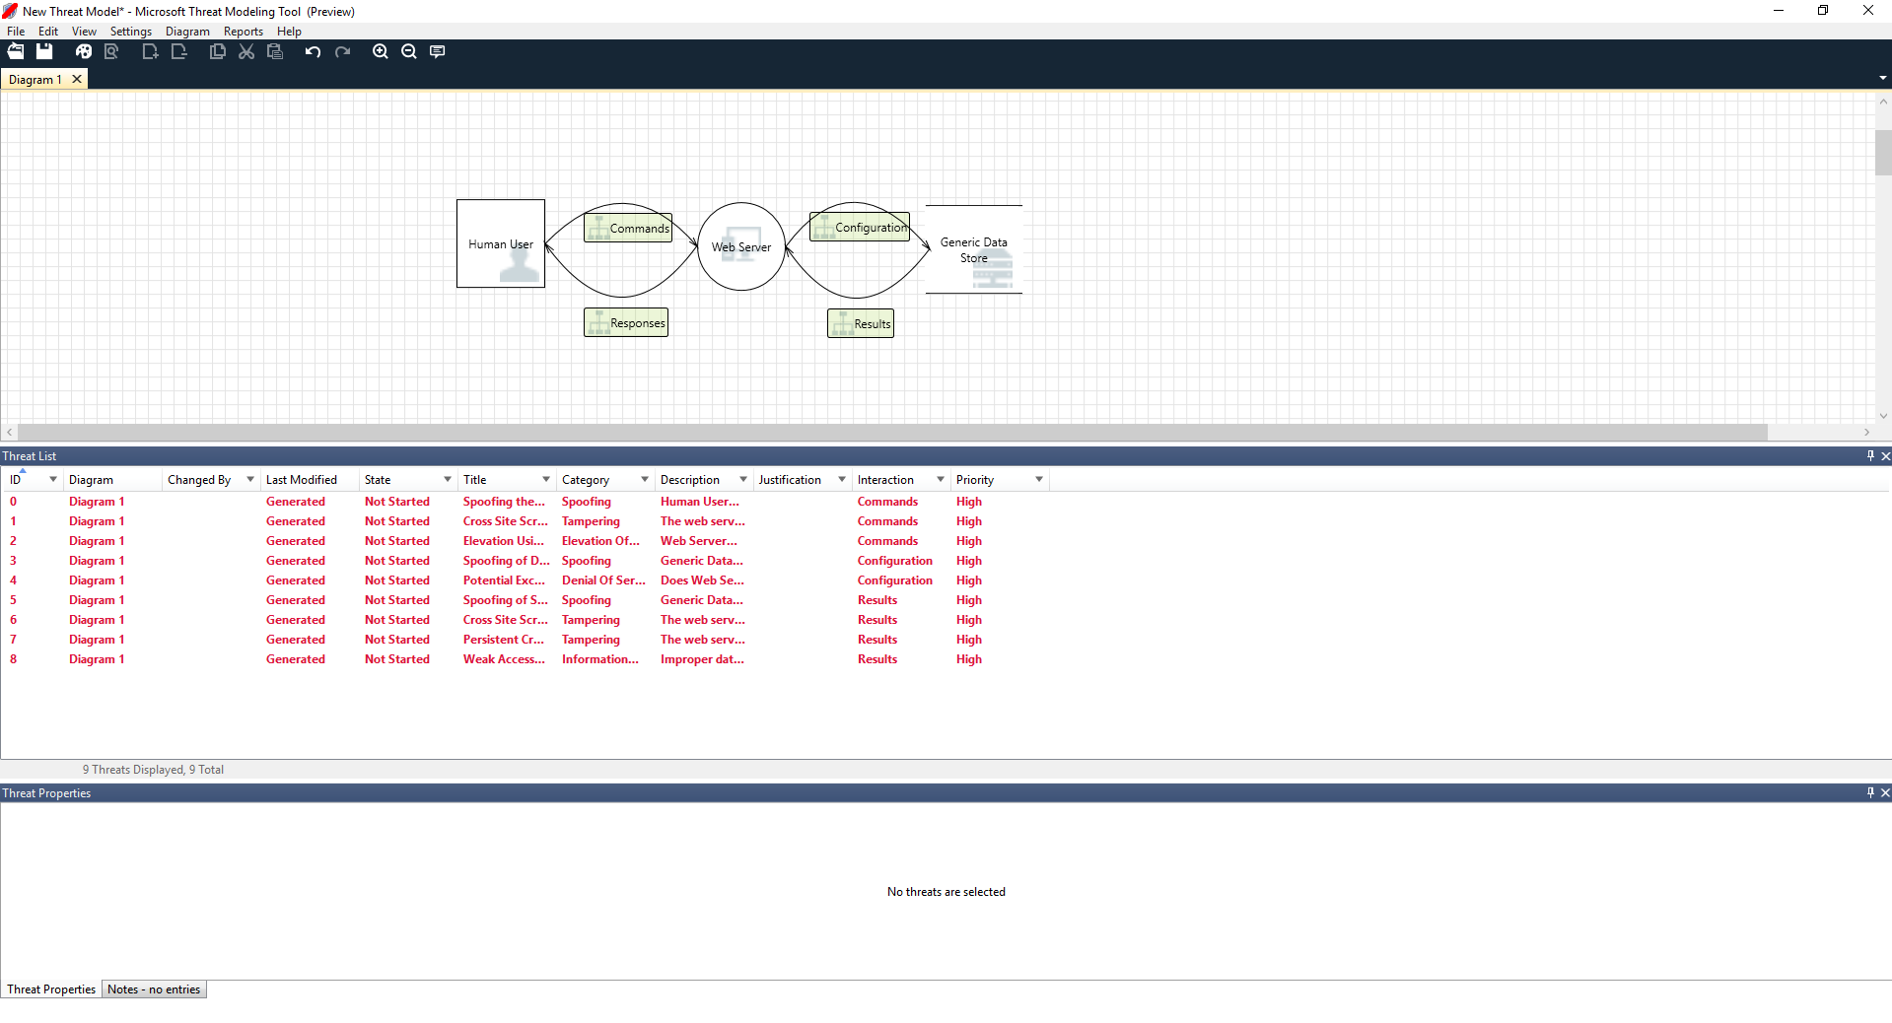
Analyzing threats

Slide 18
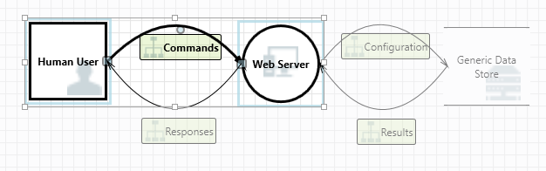
Analyzing threats

Slide 19
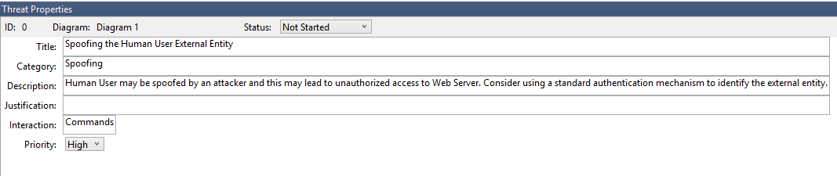
Analyzing threats

Slide 20
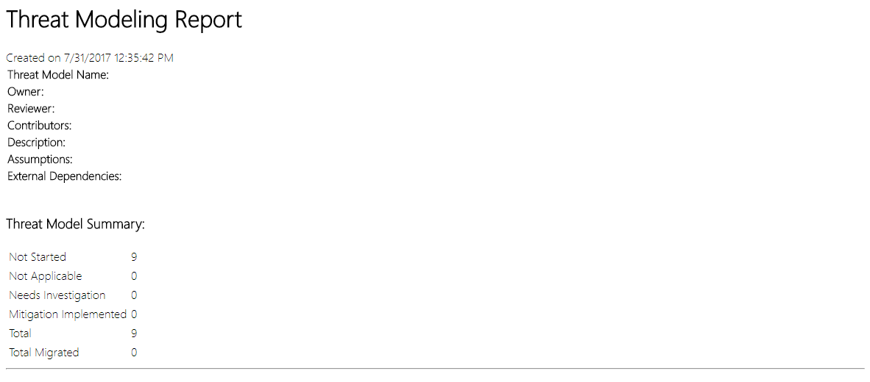
Reports & sharing

Slide 21
Reports & sharing

Slide 22
Reports & sharing

Slide 23
REFERENCES
https://dev.to/petermbenjamin/demystifying-stride-threat-models-230m
https://en.wikipedia.org/wiki/STRIDE_(security)
https://www.microsoft.com/en-us/securityengineering/sdl/threatmodeling
https://docs.microsoft.com/en-us/azure/security/develop/threat-modeling-tool

